Slide 1




Cambridgeshire and Peterborough clinical commissioning group
Focus on Location and infrastructure

Slide 2

Meet the team
Edward Tyrer
Professional Doctorate
Team Lead
Rocco Abazia
MSc Project Management
Unyime Inoh
MSc Information and Communication Technology
Em Taylor
BA (Hons) Criminology and Sociology
Erandi Silva
MSc Applied Bioscience

Slide 3

Contents
Client challenge
Logic tree
Situation analysis
Recommendations

Slide 4

Client challenge
How do we get local people to talk to us about health services with a focus on location and infrastructure?

Slide 5
Building the Logic tree
LEVEL 01
LEVEL 02
LEVEL 03
LEVEL 04
How do we get local people to talk to us about health services with a focus on location and infrastructure?
What current consultation/communication channels are adopted?
What methods are currently used
Who are the target audience and who generally responds?
What do we mean by location and infrastructure?
What coverage do we have for services?
Is the current infrastructure accessible for all?
Review of how and through what methods adopt, e.g. The Big Conversation
Analyse feedback and responses from previous exercises. Any gaps in target population
Assess what and where are services located against population
Review feedback from previous engagement and consultation exercises

Slide 6
Analysing the situation
Current methods
Leaflets & posters
Newspaper & Radio ads
Target audience & responders
No fixed target
Generally respond 16<people age<75+
Coverage of services
Older people
NHS 111 service → hearing/learning disabilities
Infrastructure accessibility
All health and services including GP, pharmacies, hospitals etc
Website & Social media
Face-to-face engagement
No answer <16
Technological difficulties
Excluding dentists & opticians

Slide 7
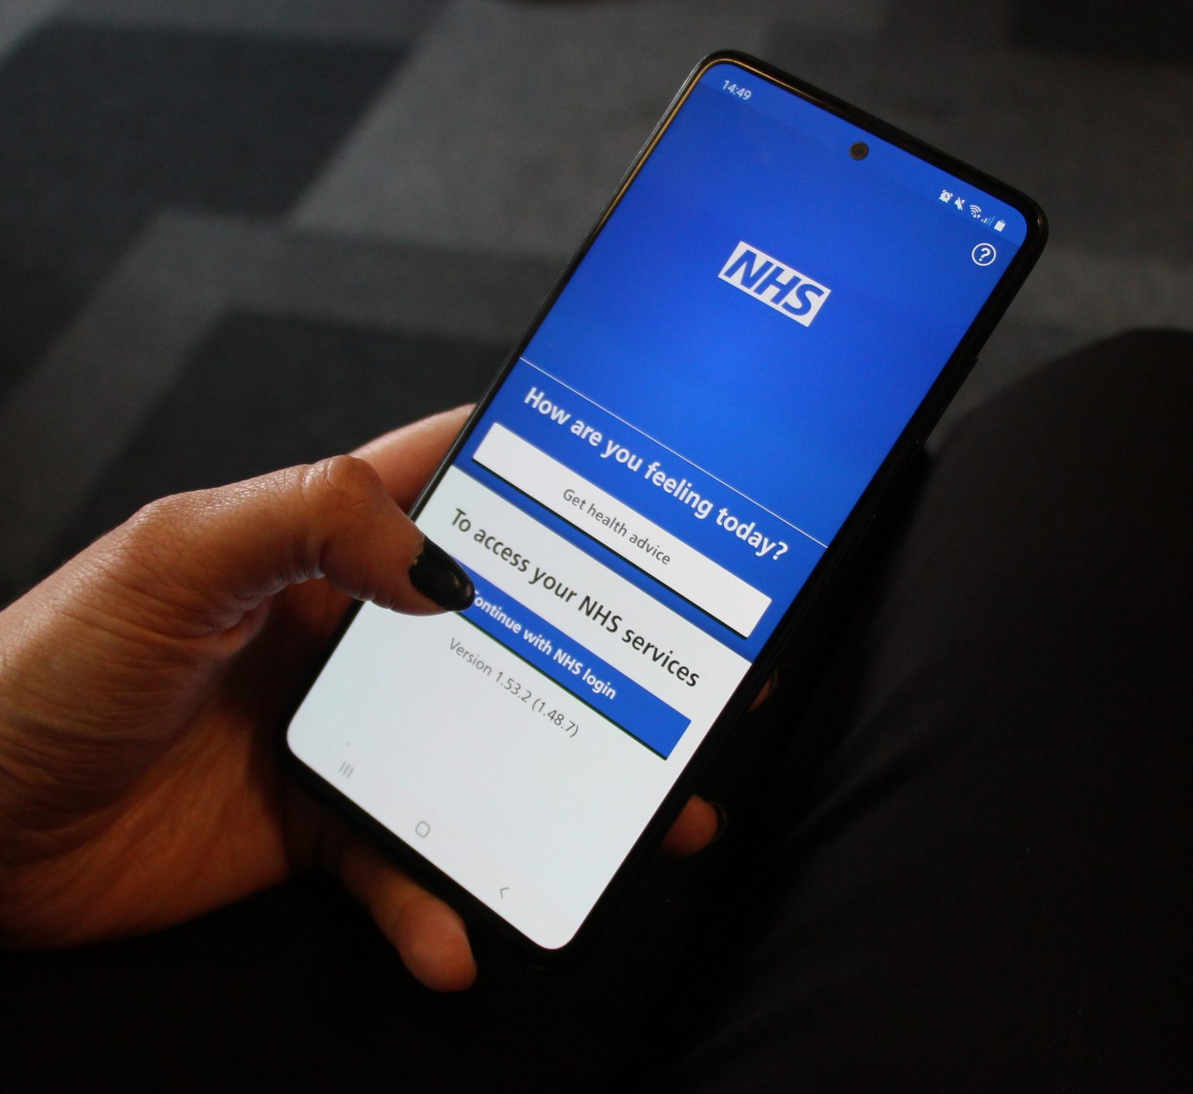
Recommendation 01
Maximising the usage of NHS mobile app
Implementation
As an added feature to the existing NHS mobile app

Slide 8

Recommendation 02
Introducing a method of incentivization
Implementation
Receiving points after providing feedbacks
More feedbacks → more points

Slide 9

Recommendation 03
Partnerships and Key Stakeholder Engagement
Implementation
Review of post-Covid working
Existing partnership and network utilisation
Better cross-working information

Slide 10

Team members contact details
Edward Tyrer | etpt100@pgr.aru.ac.uk edward@edwardtyrer.co.uk
Rocco Abazia | ra841@student.aru.ac.uk abaziarocco@gmail.com
Unyime Inoh | uei102@student.aru.ac.uk inohunyime@gmail.com
Em Taylor | et458@student.aru.ac.uk emily.taylor2001@gmail
Erandi Silva | els180@student.aru.ac.uk silva.erandi2021@gmail.com

Slide 11

Thank you! Any questions?

